Slide 1
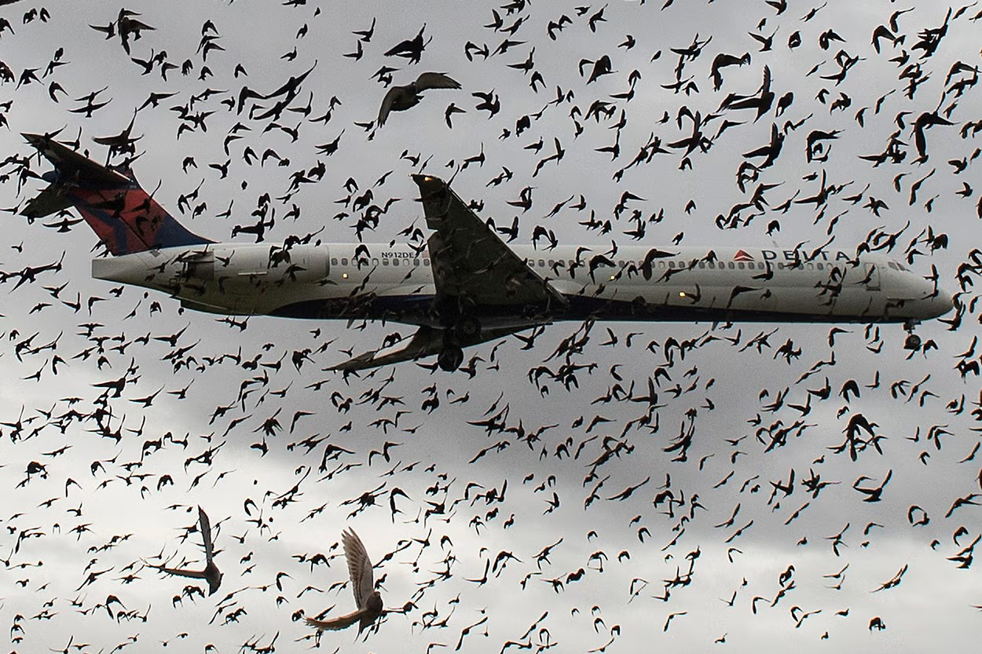
Data Visualization of Bird Strikes
2000 – 2011

Slide 2
INTRODUCTION
A bird strike is strictly defined as a collision between a bird and an aircraft which is in flight or on a take-off or landing roll. The term is often expanded to cover other wildlife strikes - with bats or ground animals. Bird Strike is common and can be a significant threat to aircraft safety.
For smaller aircraft, significant damage may be caused to the aircraft structure and all aircraft, especially jet-engine ones, are vulnerable to the loss of thrust which can follow the ingestion of birds into engine air intakes. This has resulted in several fatal accidents.
Bird strikes may occur during any phase of flight, but are most likely during the take-off, initial climb, approach and landing phases due to the greater numbers of birds in flight at lower levels.
To have a closer look the following document visually depicts the data collected on Bird Strikes by FAA between 2000-2011.

Slide 3
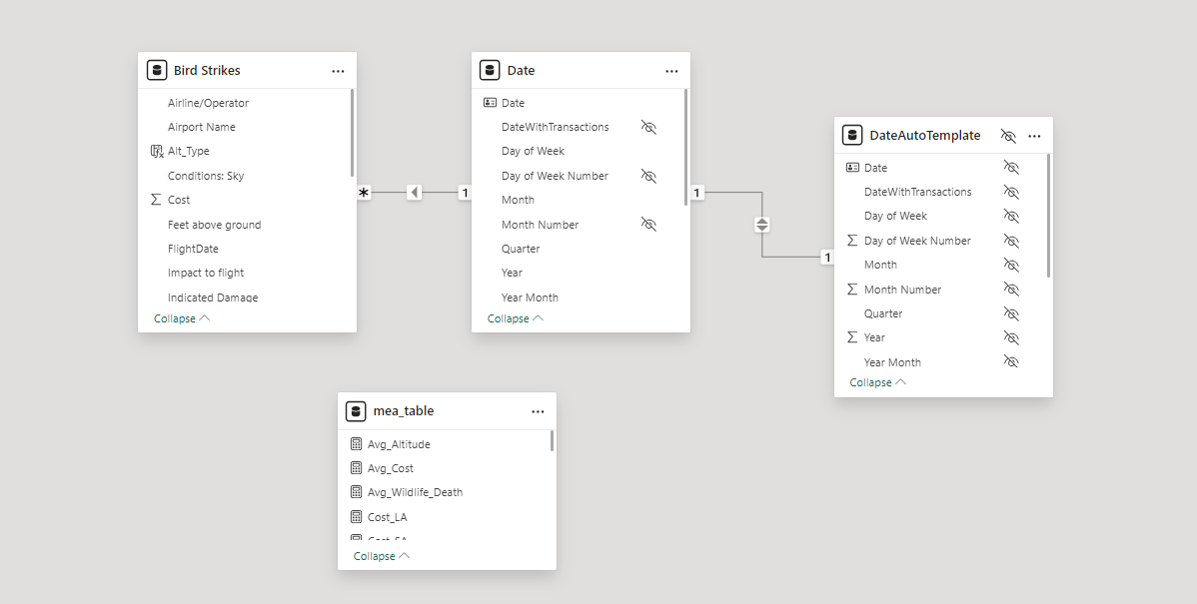
DATASET OVERVIEW AND DATA MODEL
The Dataset consists of 1 File.
Bird Strike.csv
The following tables were created using an external tool BRAVO :
Date
DateAutoTemplate
mea_table
The data was imported to Power BI and the data model created is shown.
This data is used to generate insights and to uncover key findings.

Slide 4
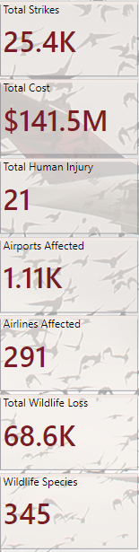
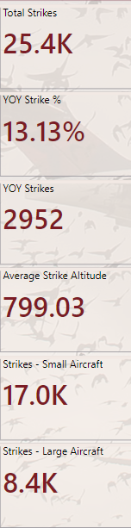
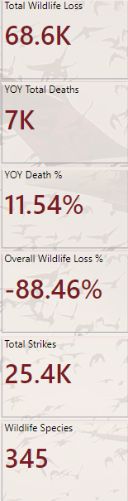
KPI OVERVIEW
This report presents a comprehensive analysis of the Bird Strikes between the year 2000 – 2011.
The data covers key metrics across multiple airports across various states in the USA.
The report is divided into segments and appropriate calculations were applied to calculate the KPIs.

Slide 5
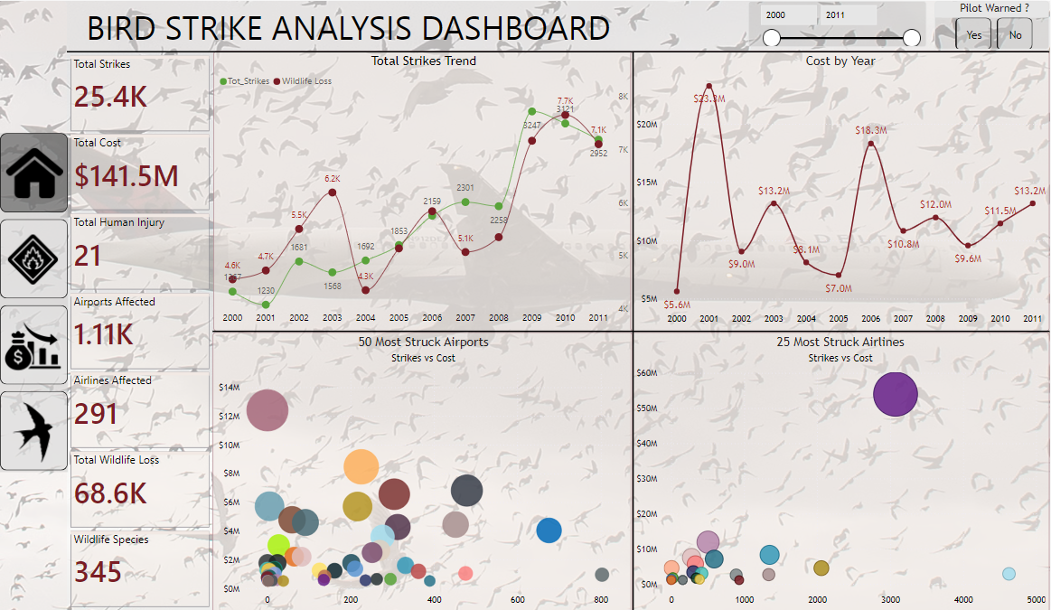
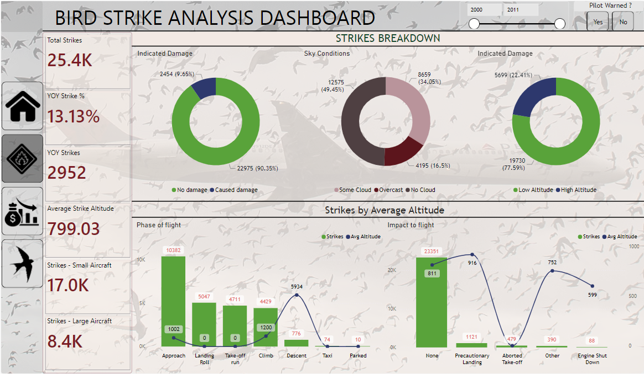
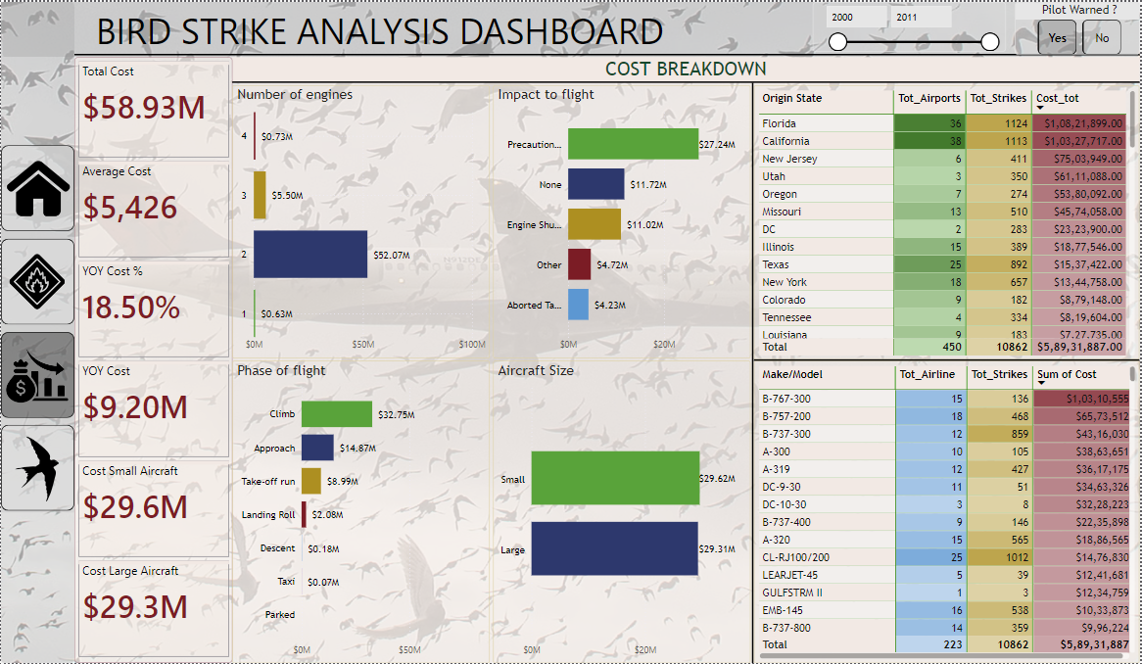
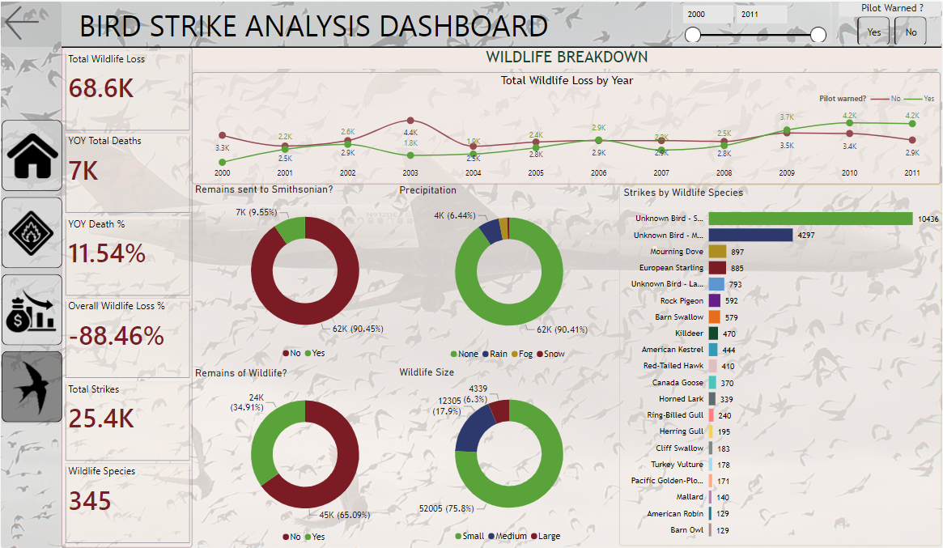
DASHBOARD OVERVIEW
The report is divided into 4 sections:
Overview – An overview of the strikes and costs.
Strikes – Breakdown of Strikes based on various factors.
Cost – Cost Breakdown by Airline and the make of the airplane
Wildlife – Breakdown of Wildlife Loss.

Slide 6
Data Visualization of Bird Strikes
THANK YOU

